Slide 1
Integrated Literacy Assignment
By: Rachel Trisch

Slide 2
GLCE
3-H3.0.9
Describe how Michigan attained statehood

Slide 3
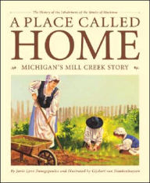
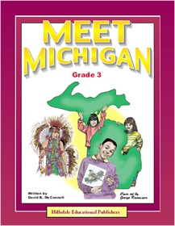
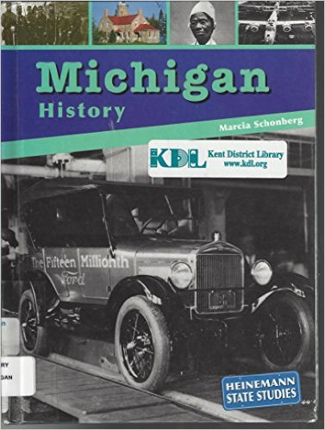
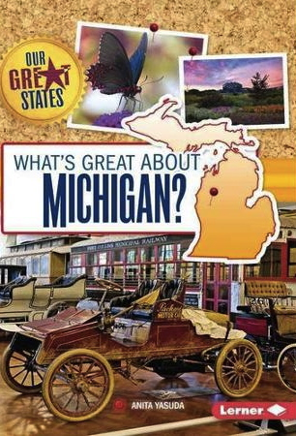
Books
-A Place Called Home: Michigan’s Mill Creek Story
By: Janie Lynn Panagopoulos
-Meet Michigan
By: David B. McConnell
-Michigan History
By: Marcia Schonberg
-People of Michigan
By: Marcia Schonberg
-What’s Great About Michigan?
By: Anita Yasuda

Slide 4
State Song
https://www.youtube.com/watch?v=A9R81q0DLP0

Slide 5
Michigan, My Michigan
https://www.youtube.com/watch?v=Q0l2mfmP81c

Slide 6
Timeline Activity
Cut out events related to Michigan becoming a state on the timeline and have students work together as a class or in groups to put events back on in the correct order.

Slide 7
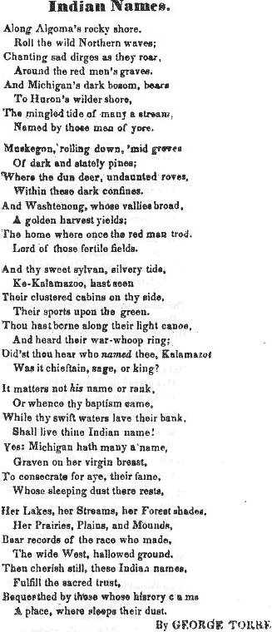

Slide 8
Websites
http://www.enchantedlearning.com/usa/states/michigan/
-This website contains information about the statehood of Michigan, such what makes Michigan unique from the other states. Examples include the story behind the state flag, and important Michigan symbols such as the state flower, bird, and tree.
http://seekingmichigan.org/wp-content/uploads/2012/07/mitten_northwest-ordinance.pdf
-This website is about the Northwest Ordinance, which carved out an area of land into a territory that would eventually become Michigan. This is referred to as the “Highway” for the creation of Michigan.

Slide 9
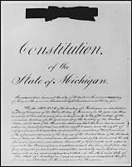
Michigan Constitution

Slide 10
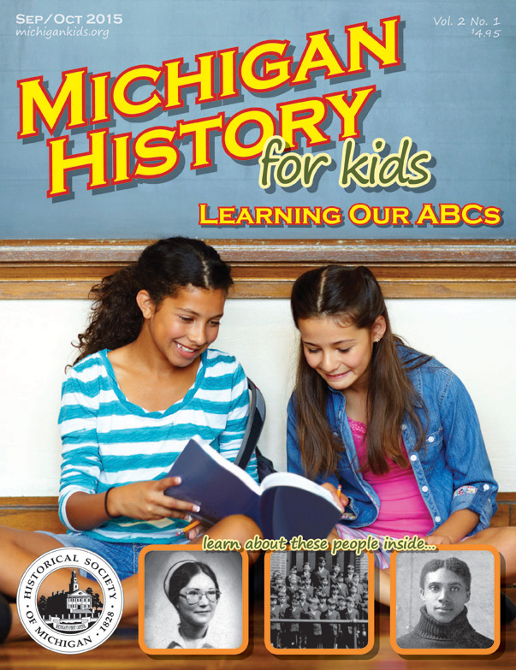
Magazines
-Michigan History for Kids is a magazine aimed at grades 3-4 that provides useful information and fun activities about the history of Michigan, including it’s journey to statehood.

Slide 11
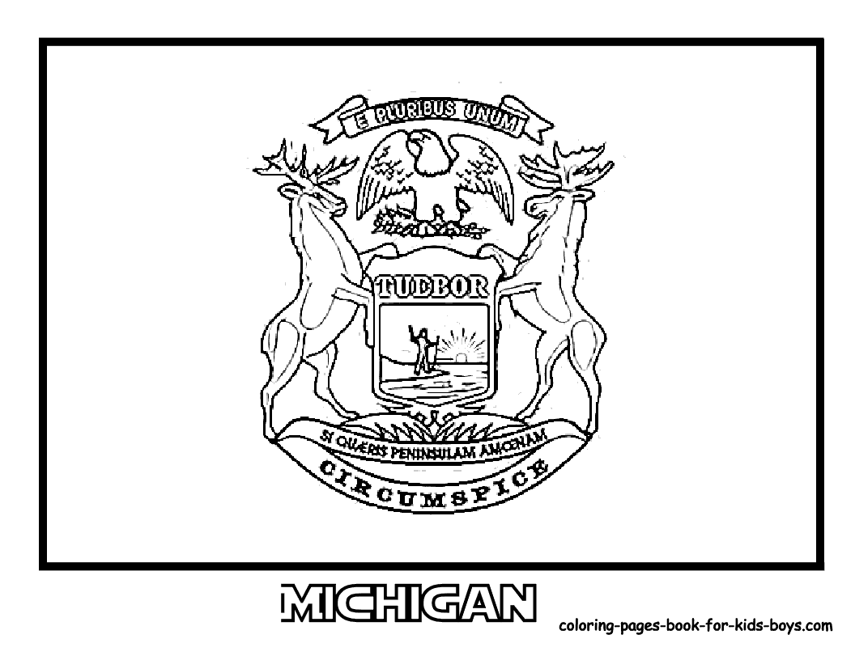

Slide 12
Video
https://www.youtube.com/watch?v=oipxokmazlg

Slide 13
References
Panagopoulos, J. (2001) A Place Called Home: Michigan’s Mill Creek Story. Ann Arbor, MI: Sleeping Bear Press
McConnell, D. Meet Michigan. Hillsdale, MI: Hillsdale Educational Press
Schonberg, M. (2003) Michigan History. Heinemann Library Publishing
Schonberg, M. (2003) People of Michigan. Heinemann Library Publishing
Yasuda, A. (2015) What’s Great About Michigan? Lerner Publishing Group
Alex J. 2011, Oct. 30. Michigan’s State Song Rare. Retrieved from https://www.youtube.com/watch?v=A9R81q0DLP0
Eng. Hadeel. 2013, Feb 1. Michigan, My Michigan. Retrieved from https://www.youtube.com/watch?v=Q0l2mfmP81c

Slide 14
MICHIGAN TIMELINE of Awesome Achievements and Events (n.d.). In Hillsdale Educational Publishers. Retrieved from http://www.hillsdalepublishers.com/
Native American History in Michigan: An Introduction (n.d.). In Students On Site. Retrieved from http://www.umich.edu/~bhlumrec/programs_centers/artsofcitizenshipprogram/www.artsofcitizenship.umich.edu/sos/topics/native/index.htm
Michigan Facts, Maps, and State Symbols (n.d.). In Enchanted Learning. Retrieved from http://www.enchantedlearning.com/usa/states/michigan/
The Northwest Ordinance (n.d.). In The Mitten. Retrieved from http://seekingmichigan.org/wp-content/uploads/2012/07/mitten_northwest-ordinance.pdf
(n.d.). In Constitution of Michigan of 1835. Retrieved from https://www.michigan.gov/documents/hal_mhc_sa_1835_MI_Constitution_51420_7.pdf
(2015, September). Michigan History For Kids, 2(1). Retrieved from http://michigankids.org/

Slide 15
Michigan State Flag Coloring Page (2015). In AZ Coloring. Retrieved from http://azcoloring.com/michigan-state-flag-coloring-page
Evlint19. 2012, Oct.17. History of Michigan: From Native Americans to Statehood. Retrieved from https://www.youtube.com/watch?v=oipxokmazlg

