Slide 1
Integrated Literacy Assignment
Kaela Sakorafis

Slide 2
GLCE
2-G1.0.2 Use maps to describe the spatial organization of the local community by applying the concepts including relative location, and using distance, direction, symbols and the key or legend.

Slide 3
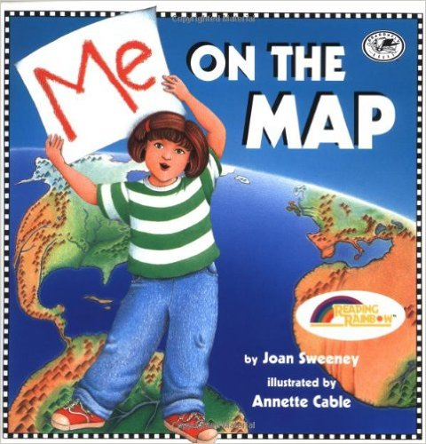
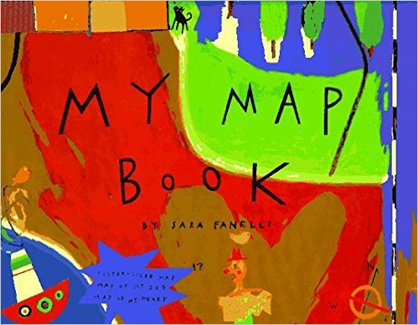
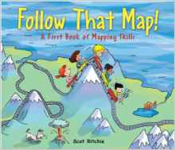
Books
Me on the Map
BY: Joan Sweeney
Mapping Penny’s World
BY: Loreen Leedy
Follow That Map
BY: Scot Ritchie
My Map Book
BY: Sara Fanelli

Slide 4
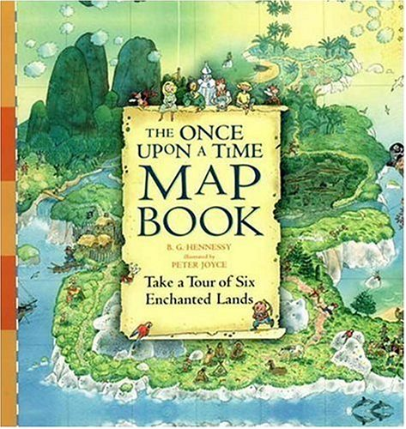
INTERACTIVE BOOK
The Once upon a Time Map Book
Provides fold out maps that students can read in order to solve certain puzzles

Slide 5
Music
How to Read a Map Song
https://www.youtube.com/watch?v=txsmjOItqWE
Directions to Nowhere
http://songsforteaching.com/geography/howtoreadamap/directionstonowhere.htm
When something round gets flattened out, you get distortion.
As I tried to make some sense of things I saw stars and squares and little flat rings I finally found an "N" which meant of course.....
.....
So I twisted the map 'til things looked right.....
.....
Well I got un-lost and finished my trip. But I'd like to share this little tip......
.....
You need to look at the scale and key.....
I was takin' a trip the other day When I got confused about which way I was to turn so in nothin' flat I found I was lost, and needed a map.
Which way is north? What's the Scale? What does THIS mean?
You know our world is mostly round But maps are flat and so I found, That things don't look like they really are Whether you're in a plane, a ship or a car.

Slide 6
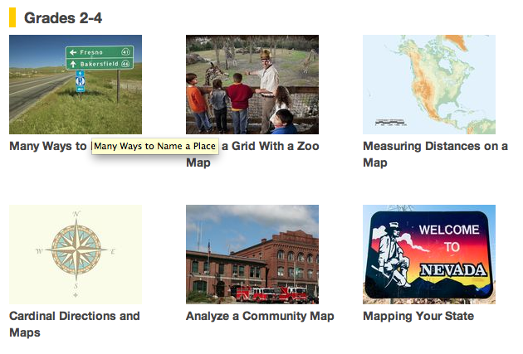
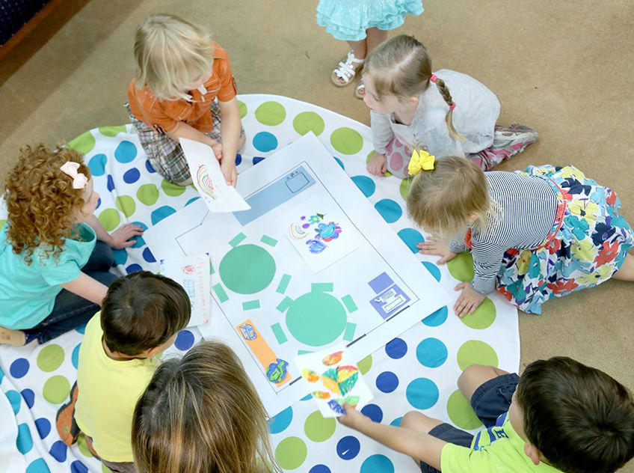
Website
National Geographic: Provides information on spatial organization of maps for all different grade levels
http://education.nationalgeographic.com/map-skills-elementary-students/

Slide 7
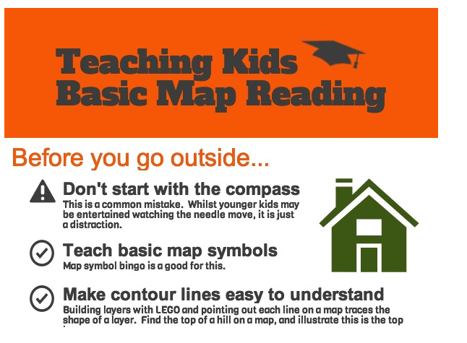
WEBSITe
Get Out with the Kids
http://www.getoutwiththekids.co.uk/family-hiking/teaching-kids-map-reading/

Slide 8
Lesson plans
Lets Learn to Use a Map http://lessonplanspage.com/SSLearnToUseAMap12.htm/
Me on the Map: Students will create a map of their bedroom and their house
http://www.uen.org/Lessonplan/preview?LPid=5713

Slide 9
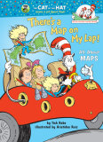
Poetry
There’s a Map on My Lap!
https://www.youtube.com/watch?v=NazvXwWumaQ

Slide 10
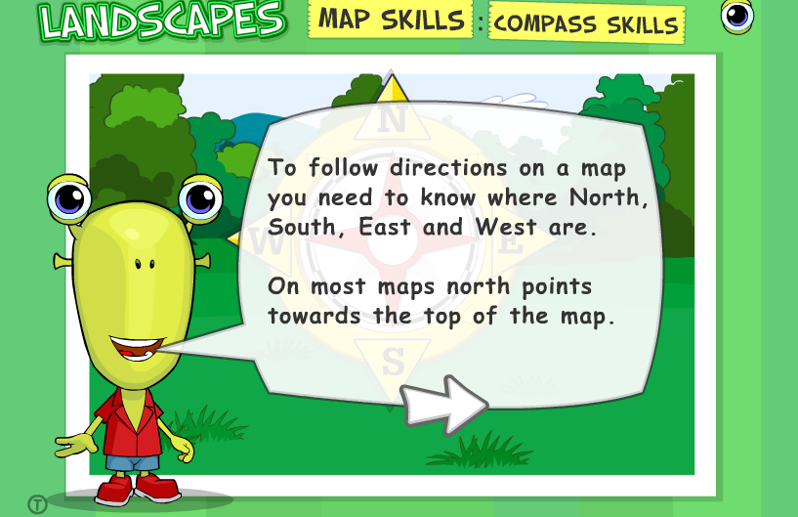
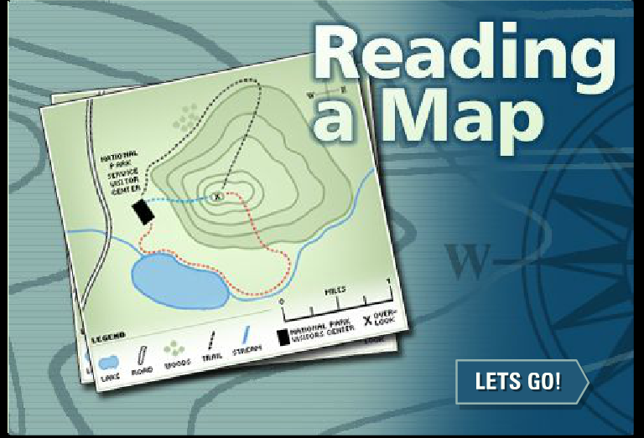
GAmes
Landscapes: Helps students learn cardinal directions
Reading a map: Provides interactive scenarios for using a map
http://www.bbc.co.uk/scotland/education/sysm/landscapes/highlands_islands/flash/land_ms_compass.swf
http://www.nps.gov/webrangers/activities/readingmap/readingmap.swf

Slide 11
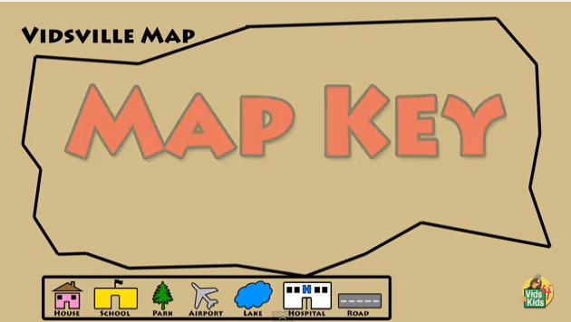
VIDEO
Vids4Kids – Learn About Maps
https://www.youtube.com/watch?v=dp8VOG8Cgag

Slide 12
citations
Act. 21: Me On the Map. (2003, August 12). Retrieved October 15, 2015.
Fanelli, S. (1995). My map book. New York: HarperCollins.
Hennessy, B., & Joyce, P. (2004). The once upon a time map book (2nd ed.). Cambridge, Mass.: Candlewick Press.
How to Read a Map. (n.d.). Retrieved October 15, 2015.
Lavergne, J. (n.d.). Let's Learn to Use a Map. Retrieved October 15, 2015.
Leedy, L. (2000). Mapping Penny's world. New York, New York: Henry Holt.
"Map Skills for Elementary Students." National Geographic Education. National Geographic Society, n.d. Web. 14 Oct. 2015.
Maps & Direction. (n.d.). Landscapes. Retrieved October 15, 2015.

Slide 13
CITATIONS
Maute, J. (n.d.). Directions to Nowhere: Song Lyrics and Sound Clip. Retrieved October 15, 2015.
Mariam Hatokay. (2011, September 17). How to read a map song. [Video file]. Retrieved from https://www.youtube.com/watch?v=txsmjOItqWE
Rabe, T., & Ruiz, A. (2002). There's a map on my lap! New York: Random House.
Ritchie, S. (2009). Follow that map!: A first look at mapping skills. Toronto: Kids Can Press.
Sweeney, J., & Cable, A. (1996). Me on the map. New York, New York: Crown.
Teaching Kids Map Reading Skills - Simple Steps. (2013, February 16). Retrieved October 15, 2015.
Vids4Kids. (2014, October 13). Learn About Maps. [Video file]. Retrieved from https://www.youtube.com/watch?v=dp8VOG8Cgag

